Slide 1
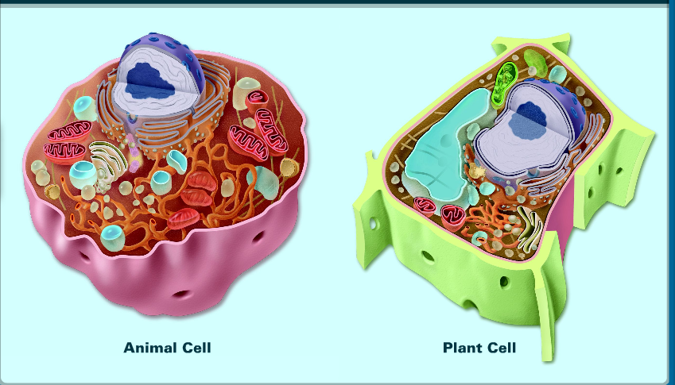
The Plant and Animal Cell
The specifics

Slide 2
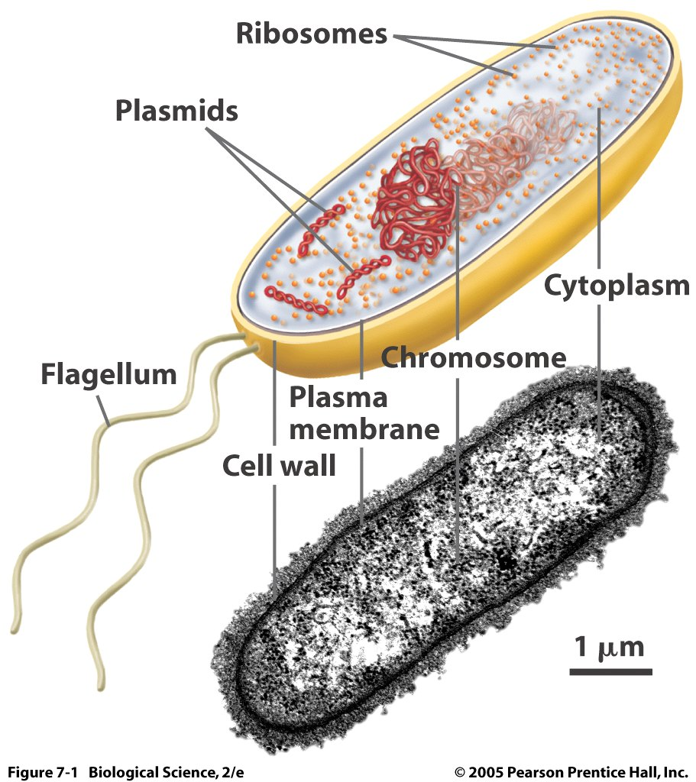
Cell Types
Prokaryotic – Do NOT contain membrane organelles. These are the first types of cells to exist when life began. They are very simple and primitive. They can only carry out one life processes at a time.
    Ex. Bacteria

Slide 3
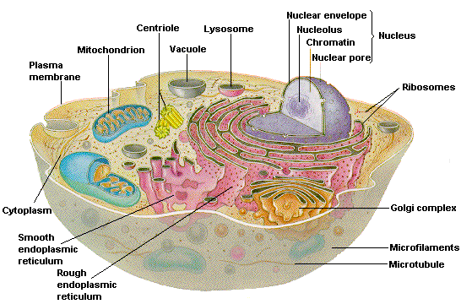
Eukaryotic – contain membrane-bound organelles, such as the nucleus.
    These are more complex and able to carry out multiple life functions at once.
    Ex. Plant and animal cells
Pro. vs. Euk.

Slide 4
Cell Size and Shape
Prokaryotic cells are smaller (as a general rule) and lack much of the internal compartmentalization (ER and Golgi) and complexity of eukaryotic cells.
No matter which type of cell we are considering, all cells have certain features in common: cell membrane, DNA, cytoplasm, and ribosomes.

Slide 5
Shape
The shapes of cells are quite varied with some, such as neuronsThe shapes of cells are quite varied with some, such as neurons, being longer than they are wide and others, like erythrocytes (red blood cells) being equidimensional.
Some cells are encased in a rigid wall, which constrains their shape, while others have a flexible cell membrane (and no rigid cell wall).

Slide 6
Size
The size of cells is also related to their functions. Eggs (ova) are very large, often being the largest cells an organism produces.
The large size of many eggs is related to the process of development that occurs after the egg is fertilized (a zygote). When the contents of the egg are used in a rapid series of cellular divisions, each requiring tremendous amounts of energy that is available in the ova.

Slide 7
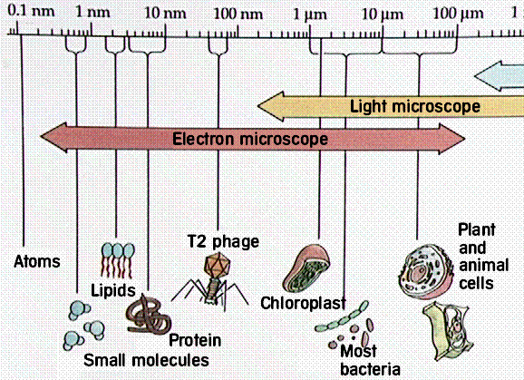

Slide 8
Cell Organelles

Slide 9
Plant and Animal Organelles
1. Plasma (or cell) membrane
2. Cytoplasm
3. Nucleus
4. Nucleolus
5. Endoplasmic reticulum (ER)
6. Ribosomes
7. Mitochondria (singular, mitochondrion)
8. Golgi complex
9. Lysosomes
10. Vacuoles
11. Centrioles
12. Cell wall
13. Chloroplasts

Slide 10
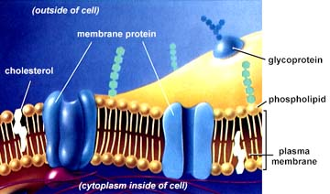
Plasma (or cell) membrane
1. Plasma (or cell) membrane: Thin, two-layered film that surrounds entire cell.
Consists of lipid molecules in which protein molecules are embedded.
It is described as semipermeable, or selectively permeable. This means it permits the passage or transport of certain materials into and out of the cell, and prevents transport of other materials.

Slide 11
Cytoplasm
2. Cytoplasm: The fluid-like material inside the plasma membrane and outside the nucleus of the cell. Various organelles are present in the cytoplasm and many biochemical processes occur in it.

Slide 12
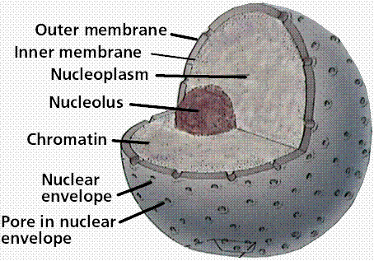
Nucleus
3. Nucleus: Structure containing the chromosomes and DNA of the cell, which carry hereditary information and direct the biochemical activities of the cell.
Separated from the cytoplasm by the nuclear membrane.

Slide 13
Nucleolus
4. Nucleolus: Structure within the nucleus that is involved in the synthesis of the rRNA found in ribosomes. (this organelle makes part of a ribosome)

Slide 14
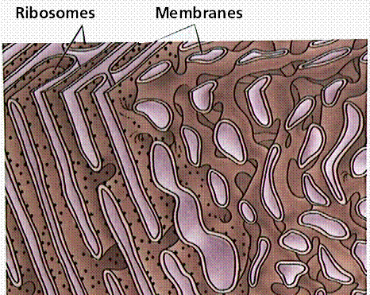
Endoplasmic reticulum (ER)
5. Endoplasmic reticulum (ER): A network of channels in the cytoplasm that function in synthesizing, transporting, detoxifing, and storing substances made in the cell.
Two types:
Rough and Smooth

Slide 15
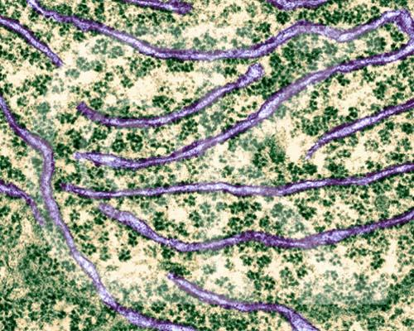
Picture of Endoplasmic Reticulm

Slide 16
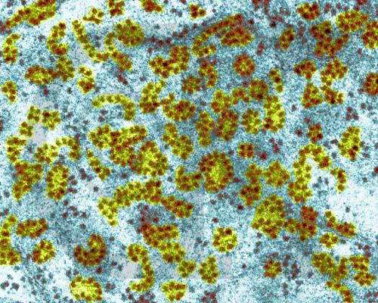
Ribosomes:
6. Ribosomes: Small structures that are the sites of protein synthesis. There are large numbers of ribosomes in the cell, which may be free in the cytoplasm or attached to the surface of the ER.

Slide 17
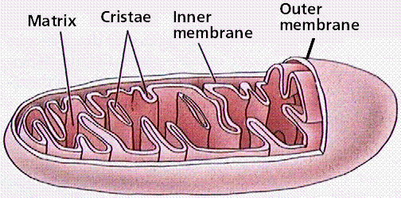
Mitochondria
7. Mitochondria (singular, mitochondrion): Sites of aerobic cellular respiration.
Most ATP of the cell is made in the mitochondria.
Converts the bonds of organic molecules into ATP

Slide 18
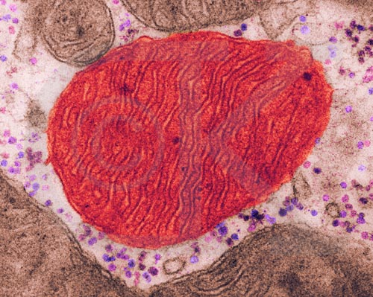
Picture of Mitochondria

Slide 19
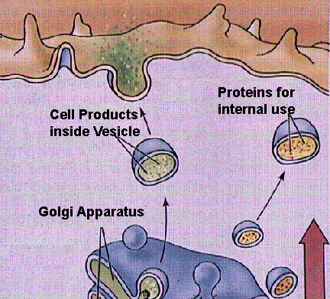
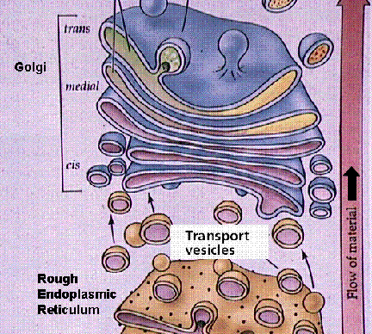
Golgi complex
8. Golgi complex: Membrane-bound channels in which products from the cell are processed and packaged.
Finishes proteins to make enzymes –lysosomes

Slide 20
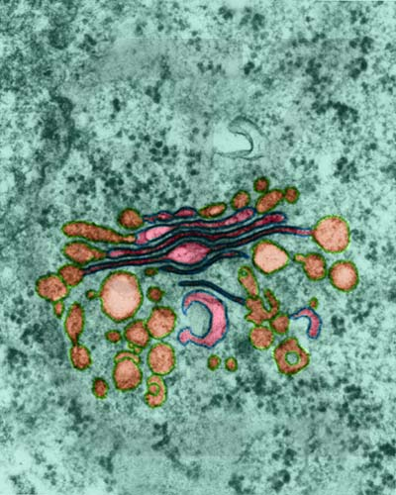
Picture of Golgi

Slide 21
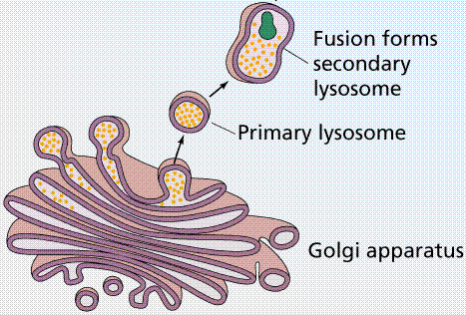
Lysosomes
9. Lysosomes: Structures that contain digestive enzymes and which take part in the digestion of food materials, old organelles, and foreign substances.

Slide 22
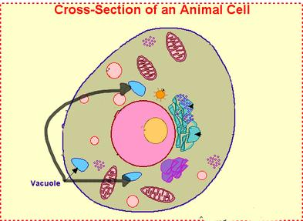
Vacuoles
10. Vacuoles: Spaces in the cytoplasm enclosed by a membrane and containing water and other materials.
Many one-celled organisms have food vacuoles in which ingested food is stored and digested
contractile vacuoles that pump excess water out of the cell.

Slide 23
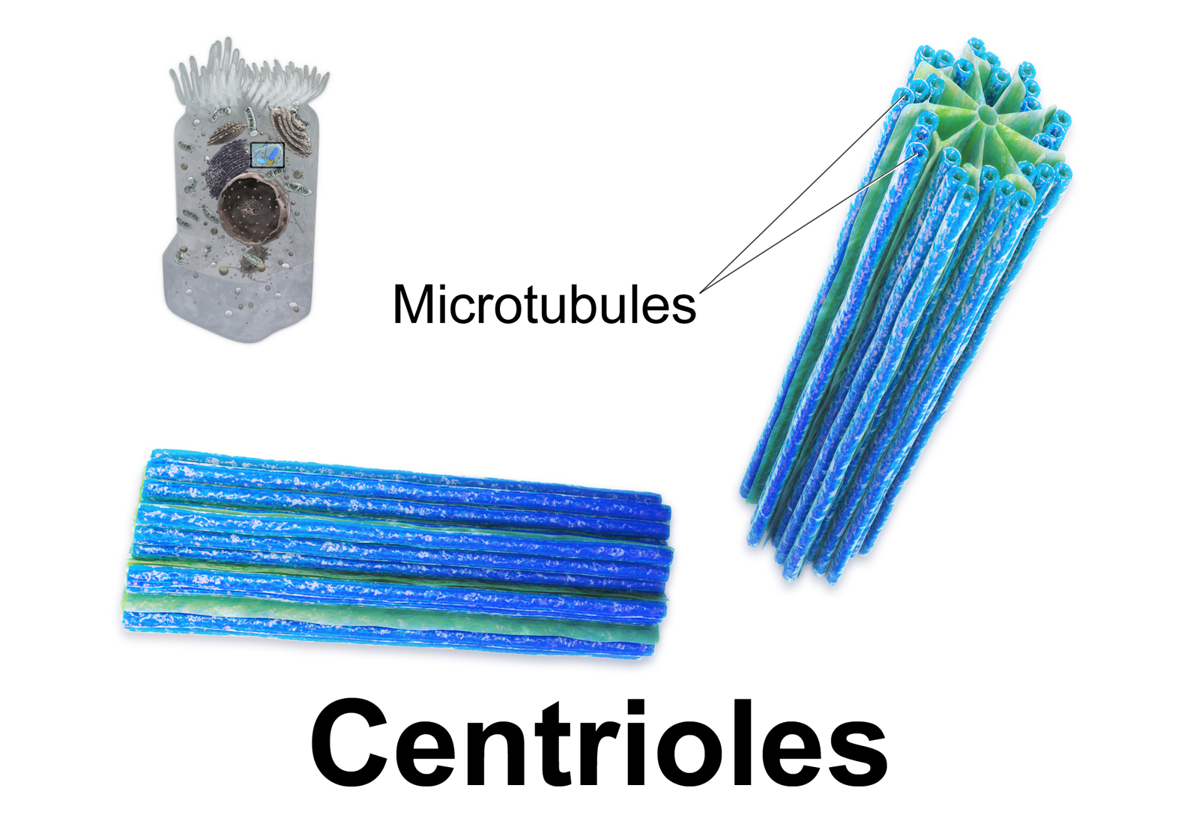
Centrioles
11. Centrioles: A pair if cylindrical structures found just outside the nuclear membrane in most animal cells. The centrioles are active during cell division.
Make microtubules and microfilaments

Slide 24
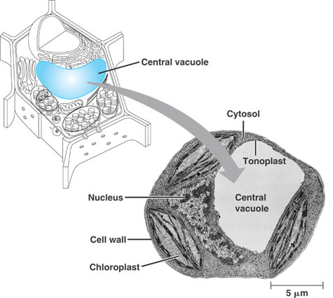
Only found in PLANT Cells
Central Vacuole: contains water, and a place to store wastes that may be harmful to the cell.

Slide 25
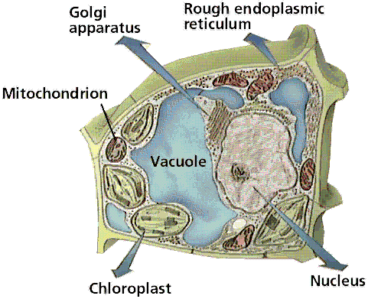
Only found in PLANT Cells
12. Cell wall: A nonliving structure composed mainly of cellulose, which surrounds the cell and gives it strength and rigidity; usually present in plant cells. It has pores or openings that permit free passage of water and dissolved substances.

Slide 26
Only found in PLANT Cells
13. Chloroplasts: Structures, found in plant cells, algae, and some other protists, that contain the pigment chlorophyll and are the sites of photosynthesis.

Slide 27
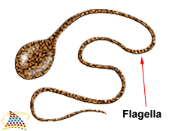
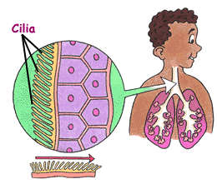
Cilia and Flagella: Structure and Movement
Cilia and Flagella – propels cells through environment and move materials over cell surface.

